Slide 1
Mod C.5 Artificial Intelligence – June 05
Agenda
Will AI Take My Job? (Level 4)
Discussion / Introduction
Mod C.5 Artificial Intelligence
Level 1 & 2 –(Due Last Week)
Level 3 – AI Job Articles – (Due Yesterday)
Level 4 – AI Job SOPs – (Complete Today)
Upcoming
Tomorrow: Heroes of Computing / Catch-Up

Slide 2

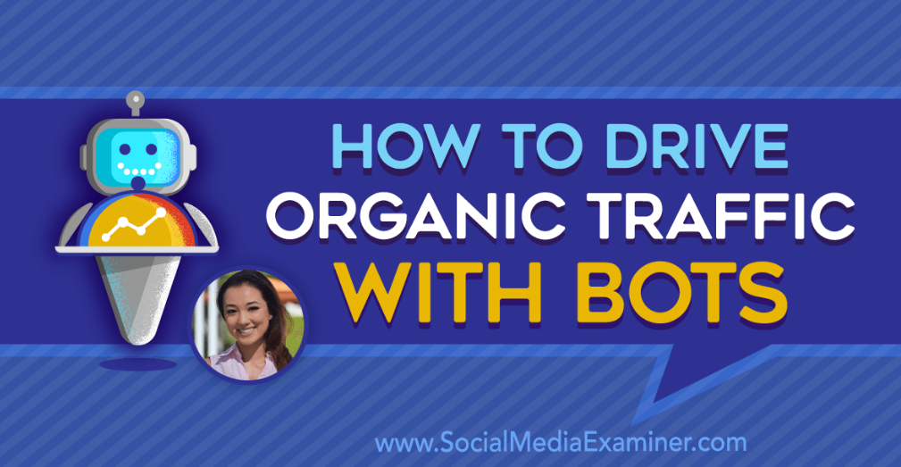
Level 3 – AI Article Reviews
Social Media Bots

Slide 3
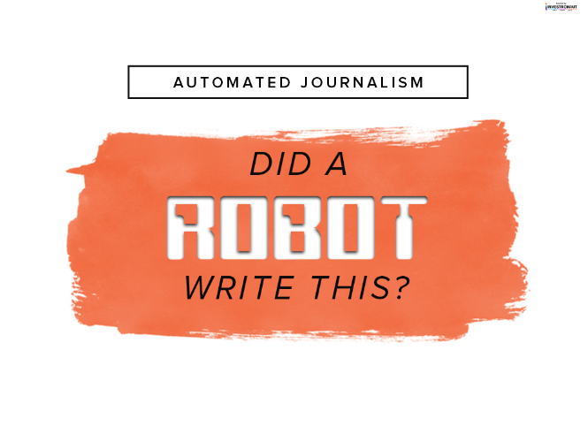
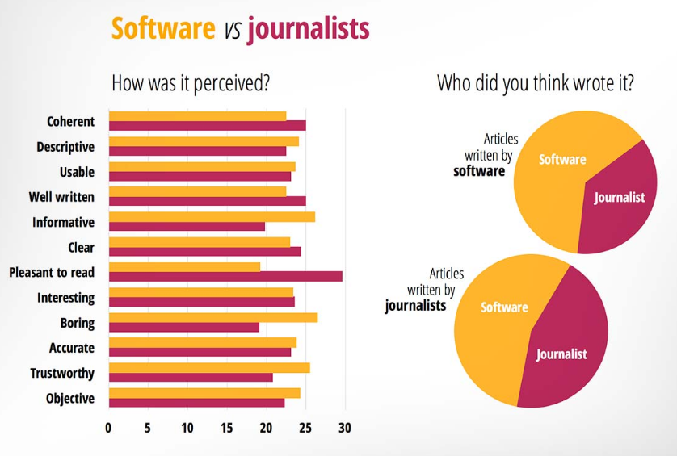
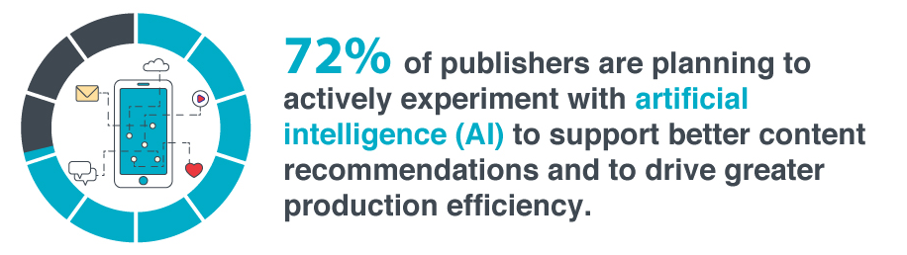
Level 3 – AI Article Reviews
Automated Journalism

Slide 4
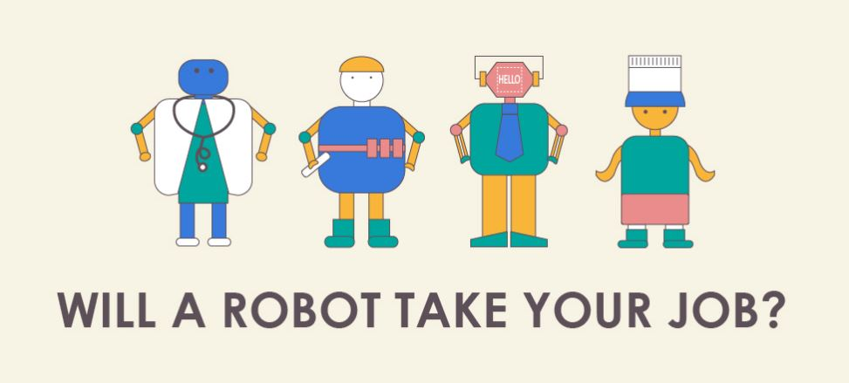
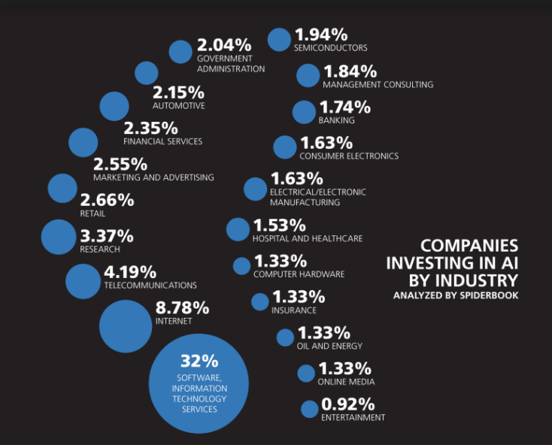
Level 4 Job SOPs
Will AI Take My Job?
Prep for Course Summative
But is it just robots?

Slide 5
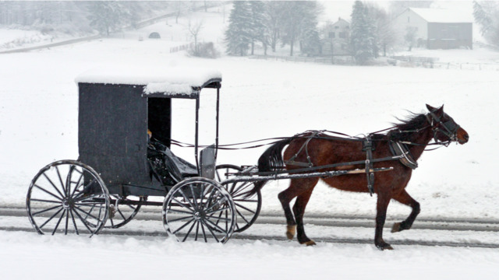
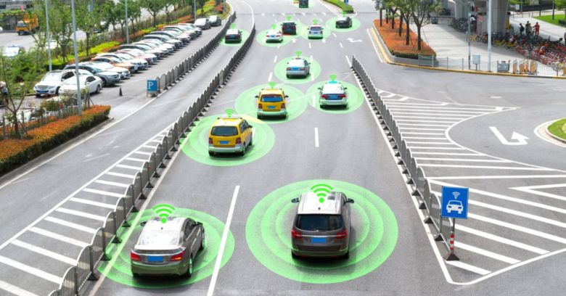
Will AI Take My Job?
Self Driving Cars

Slide 6

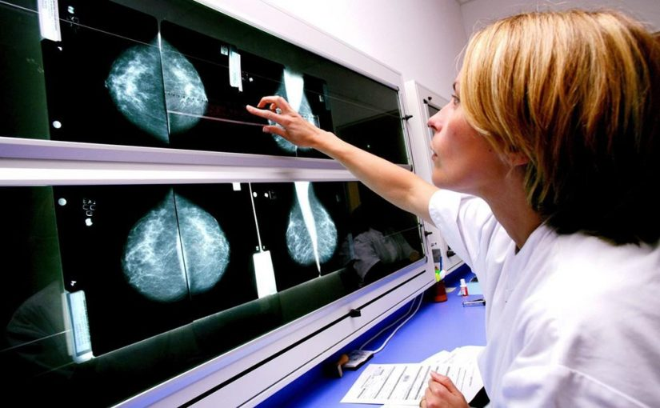
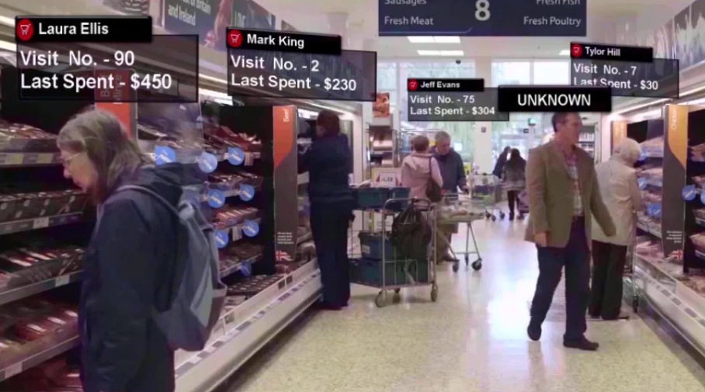
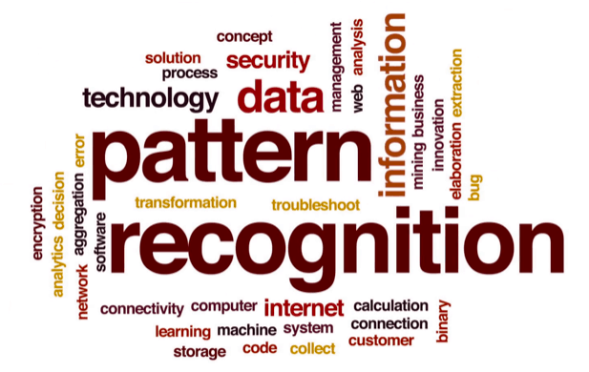
Will AI Take My Job?
Pattern Recognition

Slide 7
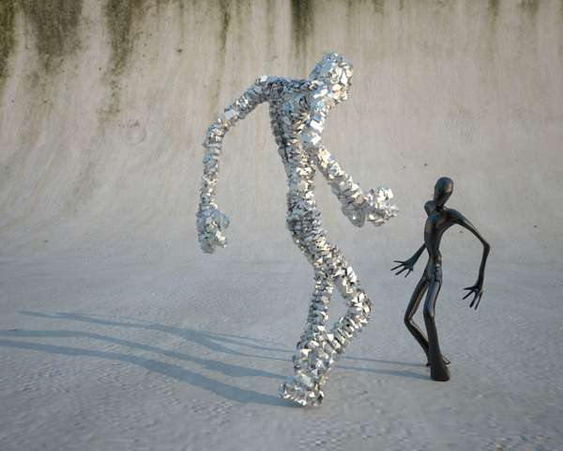
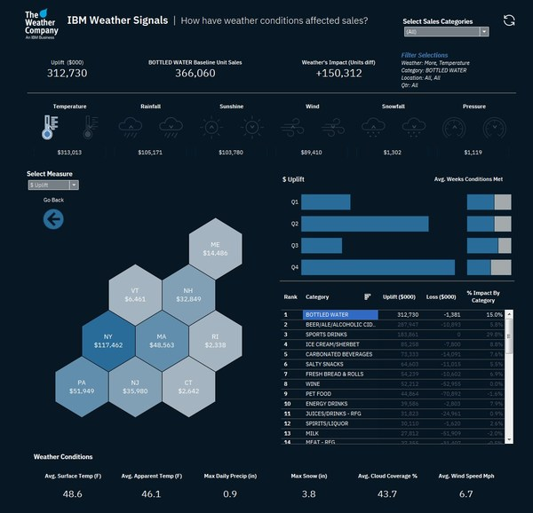
Will AI Take My Job?
Machine Learning

